Slide 1
Exception handling
BY
Y. JYOTHI

Slide 2
WHY WE NEED TO HANDLE EXCEPTION?
Converting system error messages into user friendly messages.
Two types-
Compile time
Run time
Checked, Unchecked and Error Exceptions.

Slide 3
Exceptions Handling is managed by five keywords-
Try
Catch
Finally
Throws
Throw

Slide 4
Try :
Program statements to monitor are contained within a try block.
Catch :
Code within catch block catch the exception and handle it in some
logical manner.
Finally :
Creates a block of code that will be executed after a try/catch block.
Executed whether or not an exception is thrown.

Slide 5
Throw :
To manually throw an exception we will use throw keyword.
Throws:
If a method is capable of causing an exception that it does not handle, it must specify this behavior so that callers of the method can guard themselves against that exception.
Not applicable for Error or RuntimeException, or any of their subclasses.

Slide 6
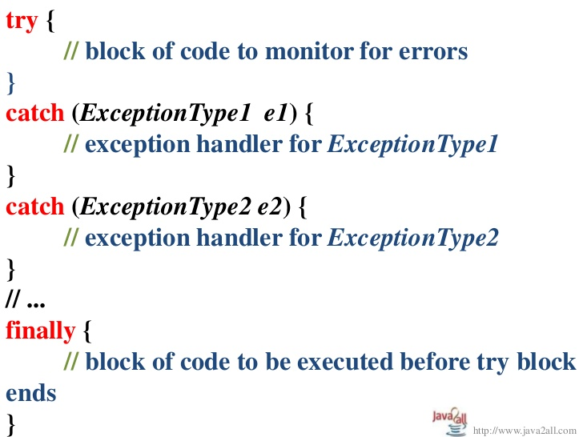
Basic Syntax :

Slide 7
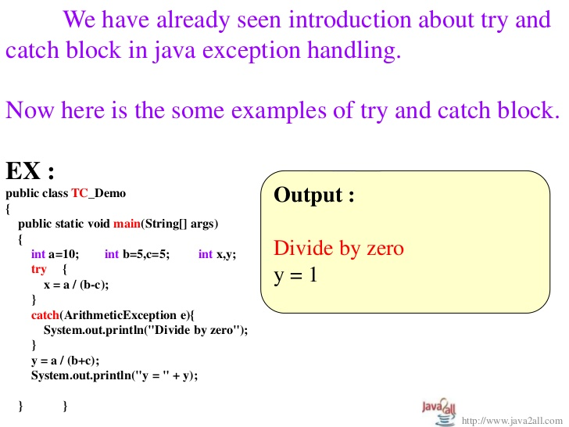

Slide 8
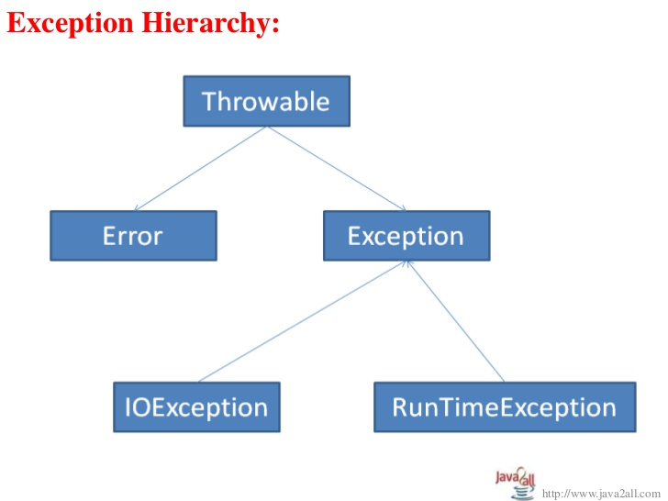

Slide 9
Types of Exceptions:
Checked (compile time) Exception:
Deals with compile time errors.
User must handle.
Java.lang.Exception
Unchecked (Run time) Exception:
Deals with runtime errors.
User don’t need handle
Java.lang.RuntimeException

Slide 10
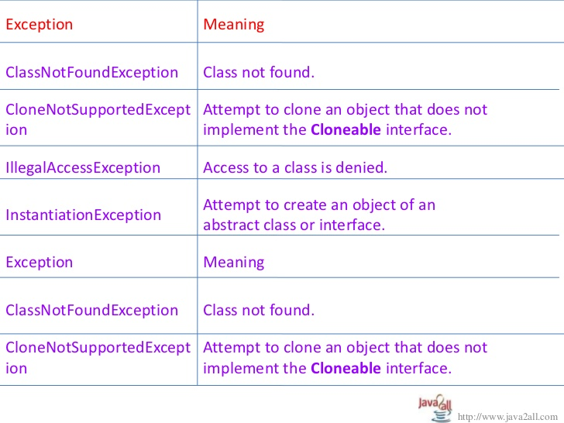
Checked Exceptions:

Slide 11
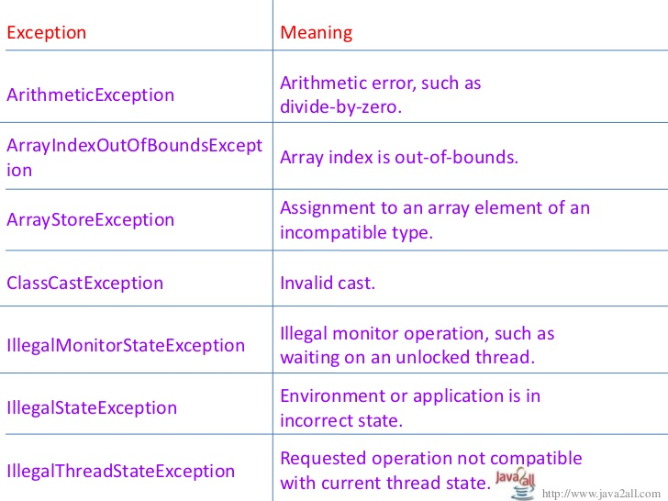
Unchecked Exceptions:

Slide 12

THANK YOU

